Slide 1

Group 22 Final Presentation 2nd Year Team Project 2021
By
Shane Mulrooney
Sean Fulton
Cree Gunning

Slide 2


Application Idea
Our Love for games
Fun but challenging experience
No end objective
Round based format

Slide 3


Target Audience
For People Who love games as much as us
Fans of top down style games
Fans of round based survival games

Slide 4


Technology and software used
Game Development Program Godot
Suited the needs and features of our game
Simple Character Animation
Collision Detection
Tile Maps
GDScript flexible and easy to learn

Slide 5
Project Plan
Preparatory Phase Full Understanding of Concept Development of Basic Functioning Game
Finishing Touches Final Testing and Debugging Phase

Slide 6
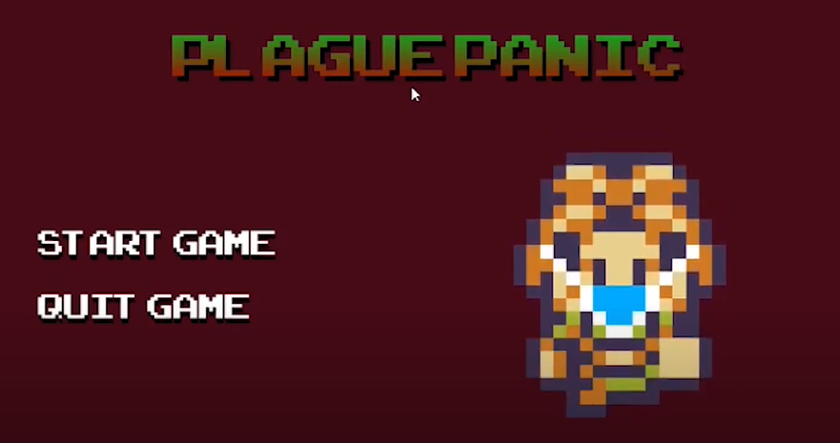
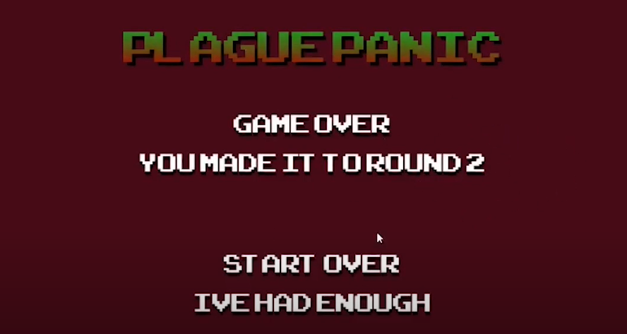
individual responsibilites
Shane
Project manager
Main menu
Cutscene
Game over
Music and sound
Player Walk Mechanic

Slide 7
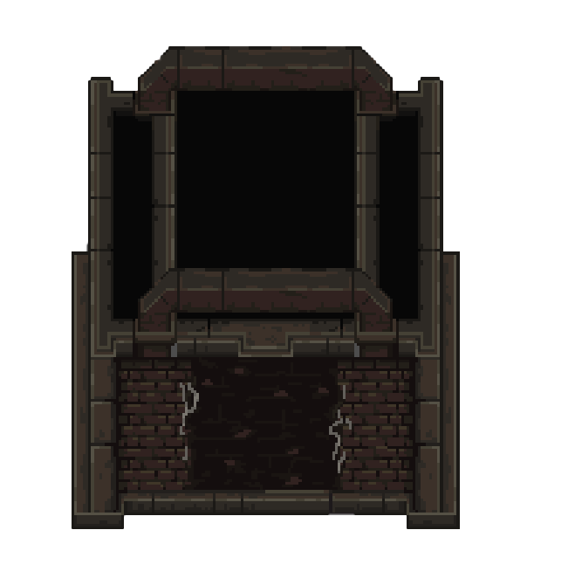
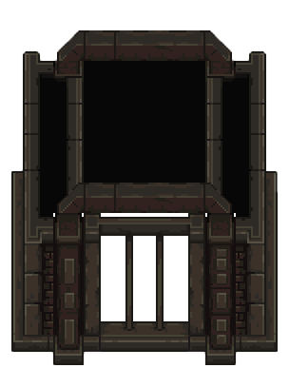
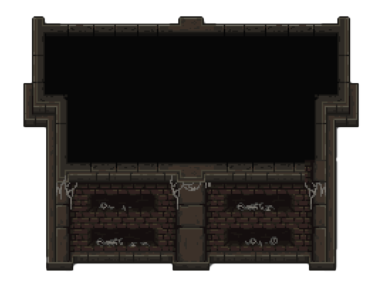
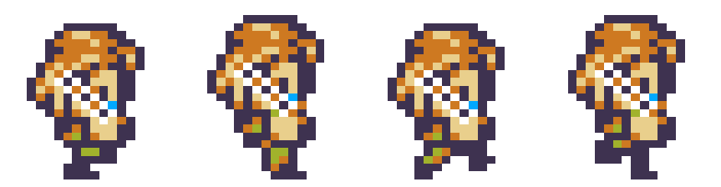
individual responsibilites
cree
Level design
Buildings and decorations
Collision detection
Main character design

Slide 8
Challenges Overcame

